Slide 2

Data manipulation with dplyr (aka tidyverse)
Notes:
So we’re doing something a little bit annoying, in that we just gave you a bunch of tools to work with data, and now we’re going to teach a WHOLE NEW set of tools that have a whole new syntax.
If you made the observation that data manipulation in what we call “Base R” is a bit clunky & hard to read, you’d be right.
So we’re going to introduce some more modern tools (called the tidyverse) that will probably streamline things a bit.

Slide 3
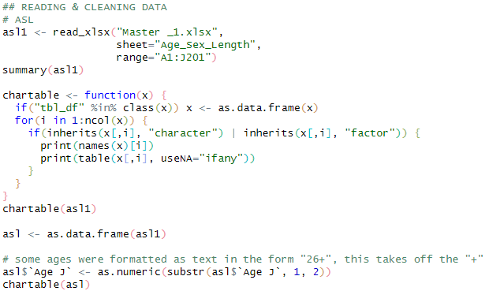
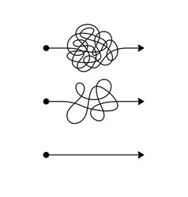
Motivation: Matt’s typical Base R data workflow…
Import MyDataFrame
MyDataFrame1
MyDataFrame2
MyDataFrame3
MyDataFrame4
Notes:
To give some motivation, here’s a bit of schematic of my typical data workflow before embracing the tidyverse…

Slide 4
Motivation: Matt’s typical Base R data workflow…
Import MyDataFrame
Baked-from-scratch syntax
Probably difficult to read for anybody other than Matt (who wrote it)
Which probably includes next-year Matt!
Requires Matt to re-create the syntax correctly every time
Has he had coffee yet?
MyDataFrame1
MyDataFrame2
MyDataFrame3
MyDataFrame4

Slide 5
Motivation: Matt’s typical Base R data workflow…
Import MyDataFrame
Create incremental data.frames?
This creates workspace clutter
Is Matt using the right one?
Or overwrite the original data.frame with every step?
SCARY!!!
MyDataFrame1
MyDataFrame2
MyDataFrame3
MyDataFrame4

Slide 6
But first, introducing the pipe operator %>%
Rule: the %>% moves the
LHS object
to the first position of the
RHS function
x %>% function1
- Is evaluated as -
function1(x)
x %>% function1(someArgs1)
- Is evaluated as -
function1(x, someArgs1)
Notes:
So hold that mental picture in your mind, while we introduce a new, extremely powerful operator: the PIPE

Slide 7
But first, introducing the pipe operator %>%
Rule: the %>% moves the
LHS object
to the first position of the
RHS function
Conversely, a piped statement begins with an object, and takes a function as its second operand
function1(x)
- becomes -
x %>% function1
x %>% function1
- is evaluated as -
function1(x)
Mental model:
What you started with
What happens to it
x %>% function1(someArgs1)
function1(x, someArgs1)
- is evaluated as -
- becomes -
function1(x, someArgs1)
x %>% function1(someArgs1)
Notes:
Maybe it’s easier to think of this the other way around.

Slide 8
Where this matters: if you have a sequence of operations
function3(function2(function1(x, someArgs1), someArgs2), someArgs3)
Or equivalently
function3(
function2(
function1(x, someArgs1),
someArgs2),
someArgs3)
x %>%
function1(someArgs1) %>%
function2(someArgs2) %>%
function3(someArgs3)
Can be rewritten as
Notes:
Where this really matters is if you have a whole sequence of operations.
You COULD write it as a nested function call, and it would work… but it’s much more natural to write steps in sequence.

Slide 9
Where this matters: if you have a sequence of operations
function3(function2(function1(x, someArgs1), someArgs2), someArgs3)
What you started with
Or equivalently
What happens to it
function3(
function2(
function1(x, someArgs1),
someArgs2),
someArgs3)
x %>%
function1(someArgs1) %>%
function2(someArgs2) %>%
function3(someArgs3)
Then what happens to that
Can be rewritten as
Then what happens to that…
Notes:
So we have this mental model of the thing we started with, then what happens to it…

Slide 10

The dplyr package (part of tidyverse)
Provides a set of functions (“verbs”) for typical data operations
All of these take a data.frame as their first argument, and return a data.frame
This means you can %>% a whole sequence in one pipeline!!
myDataFrame %>%
dataVerb1(someArgs1) %>%
dataVerb2(someArgs2) %>%
dataVerb3(someArgs3)
Notes:
So with that picture firmly in your mind…

Slide 11
Motivation: Matt’s typical Base R data workflow…
Import MyDataFrame
%>%
dataVerb1(someArgs1)
%>%
MyDataFrame1
dataVerb2(someArgs2)
%>%
MyDataFrame2
dataVerb3(someArgs3)
%>%
MyDataFrame3
dataVerb4(someArgs4)
MyDataFrame4
Notes:
So if we revisit the Base R way of wrangling data…

Slide 12
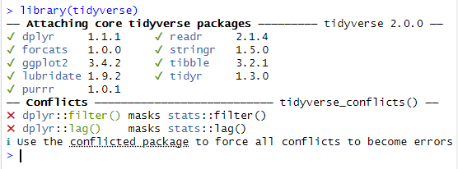
What is the Tidyverse?
The Tidyverse is a collection of packages that extend the usefulness of R, use slightly different language syntax, and play well together
I usually just load the tidyverse package (I’m lazy)
These are all the packages that get loaded at once
Letting you know that there are functions with these names in multiple packages
Notes:
So let’s explicitly talk about what I mean when I say “tidyverse”

Slide 13
First, some fake data…
catchdata <- data.frame(station = c(1, 1, 2, 2, 3, 3),
catch = c(12, 23, 44, 65, 34, 49),
hours = c(1, 2, 2, 3, 1, 1.5),
weather = c("sun", "sun", "rain", "rain", "rain", "flood"))
catchdata
station catch hours weather
1 1 12 1.0 sun
2 1 23 2.0 sun
3 2 44 2.0 rain
4 2 65 3.0 rain
5 3 34 1.0 rain
6 3 49 1.5 flood
Notes:
So! Let’s play with this, but first define some fake data

Slide 14
select(): only keep a subset of columns
catchdata
station catch hours weather
1 1 12 1.0 sun
2 1 23 2.0 sun
3 2 44 2.0 rain
4 2 65 3.0 rain
5 3 34 1.0 rain
6 3 49 1.5 flood
Note: in dplyr syntax, you no longer need the $, since the function already knows to look inside the data.frame you use with it
catchdata %>% select(station, catch)
station catch
1 1 12
2 1 23
3 2 44
4 2 65
5 3 34
6 3 49
Is there a Base R equivalent?
catchdata[ , 1:2]
Not obvious to a reader
Not as robust to changes to the data!
data.frame(station=catchdata$station, catch=catchdata$catch)
Lots of extra typing
catchdata[ , c("station", "catch")]
Kinda messy!
catchdata %>% select(-hours, -weather)
Same result with negative column names
Notes:
Select() is a way of selecting a subset of COLUMNS
So here’s our original data.frame, and here’s what a select() call looks like

Slide 15
filter(): only keep a subset of rows
catchdata
station catch hours weather
1 1 12 1.0 sun
2 1 23 2.0 sun
3 2 44 2.0 rain
4 2 65 3.0 rain
5 3 34 1.0 rain
6 3 49 1.5 flood
Any logical vector will be fine here
catchdata %>% filter(station %in% 1:2)
station catch hours weather
1 1 12 1 sun
2 1 23 2 sun
3 2 44 2 rain
4 2 65 3 rain
Is there a Base R equivalent?
catchdata[ catchdata$station %in% 1:2, ]
A little extra typing
A reader might not know what the square brackets mean
Notes:
Filter is similar, but it gives a subset of ROWS

Slide 16
mutate(): make (or transform) columns
catchdata
station catch hours weather
1 1 12 1.0 sun
2 1 23 2.0 sun
3 2 44 2.0 rain
4 2 65 3.0 rain
5 3 34 1.0 rain
6 3 49 1.5 flood
Rule: ColName = Formula…
catchdata %>% mutate(catch_rate = catch/hours)
station catch hours weather catch_rate
1 1 12 1.0 sun 12.00000
2 1 23 2.0 sun 11.50000
3 2 44 2.0 rain 22.00000
4 2 65 3.0 rain 21.66667
5 3 34 1.0 rain 34.00000
6 3 49 1.5 flood 32.66667
Is there a Base R equivalent?
catchdata$catch_rate <- catchdata$catch / catchdata$hours
This one’s actually not so bad
Notes:
Mutate() allows you to make new columns, or transform existing ones

Slide 17
mutate(): make (or transform) columns
catchdata
station catch hours weather
1 1 12 1.0 sun
2 1 23 2.0 sun
3 2 44 2.0 rain
4 2 65 3.0 rain
5 3 34 1.0 rain
6 3 49 1.5 flood
Rule: ColName = Formula…
catchdata %>%
mutate(weather = ifelse(weather=="sun", "SUN!", weather))
station catch hours weather
1 1 12 1.0 SUN!
2 1 23 2.0 SUN!
3 2 44 2.0 rain
4 2 65 3.0 rain
5 3 34 1.0 rain
6 3 49 1.5 flood
Logical
Value if TRUE
Value if FALSE
Note that this is a vector!
Is there a Base R equivalent?
catchdata$weather[catchdata$weather=="sun"] <- "SUN!"
This one’s actually not so bad

Slide 18
rename(): rename columns
catchdata
station catch hours weather
1 1 12 1.0 sun
2 1 23 2.0 sun
3 2 44 2.0 rain
4 2 65 3.0 rain
5 3 34 1.0 rain
6 3 49 1.5 flood
Check it out! It’s a pipeline!!!
catchdata %>%
select(station, catch) %>%
rename(Station_num=station, Coho_catch=catch)
Station_num Coho_catch
1 1 12
2 1 23
3 2 44
4 2 65
5 3 34
6 3 49
Rule: NewColName = OldColName
Is there a Base R equivalent?
names(catchdata)[names(catchdata)=="station"] <- "Station_Num"
names(catchdata)[names(catchdata)=="catch"] <- "Coho_catch"
Yikes, that’s awkward!!
Notes:
Rename() is awesome. I love rename().

Slide 19
left_join(): Pull values from a lookup table!
catchdata
station catch hours weather
1 1 12 1.0 sun
2 1 23 2.0 sun
3 2 44 2.0 rain
4 2 65 3.0 rain
5 3 34 1.0 rain
3 49 1.5 flood
stations
Station_num Station_name
1 1 Skeeter Slough
2 2 Itchy Island
3 3 Buzzbuzz Bay
catchdata %>%
select(station, catch) %>%
rename(Station_num=station, Coho_catch=catch) %>%
left_join(stations)
Joining with `by = join_by(Station_num)`
Station_num Coho_catch Station_name
1 1 12 Skeeter Slough
2 1 23 Skeeter Slough
3 2 44 Itchy Island
4 2 65 Itchy Island
5 3 34 Buzzbuzz Bay
6 3 49 Buzzbuzz Bay
Rule: must have a matching column name
Is there a Base R equivalent?
Yes. But … it’s painful.
Notes:
Left_join() isn’t one of the “core” dplyr functions, but it’s just so amazing we’re talking about it anyway.
Let’s say we have a lookup table of station names, and want to add a new column that pulls station name by station number.

Slide 20
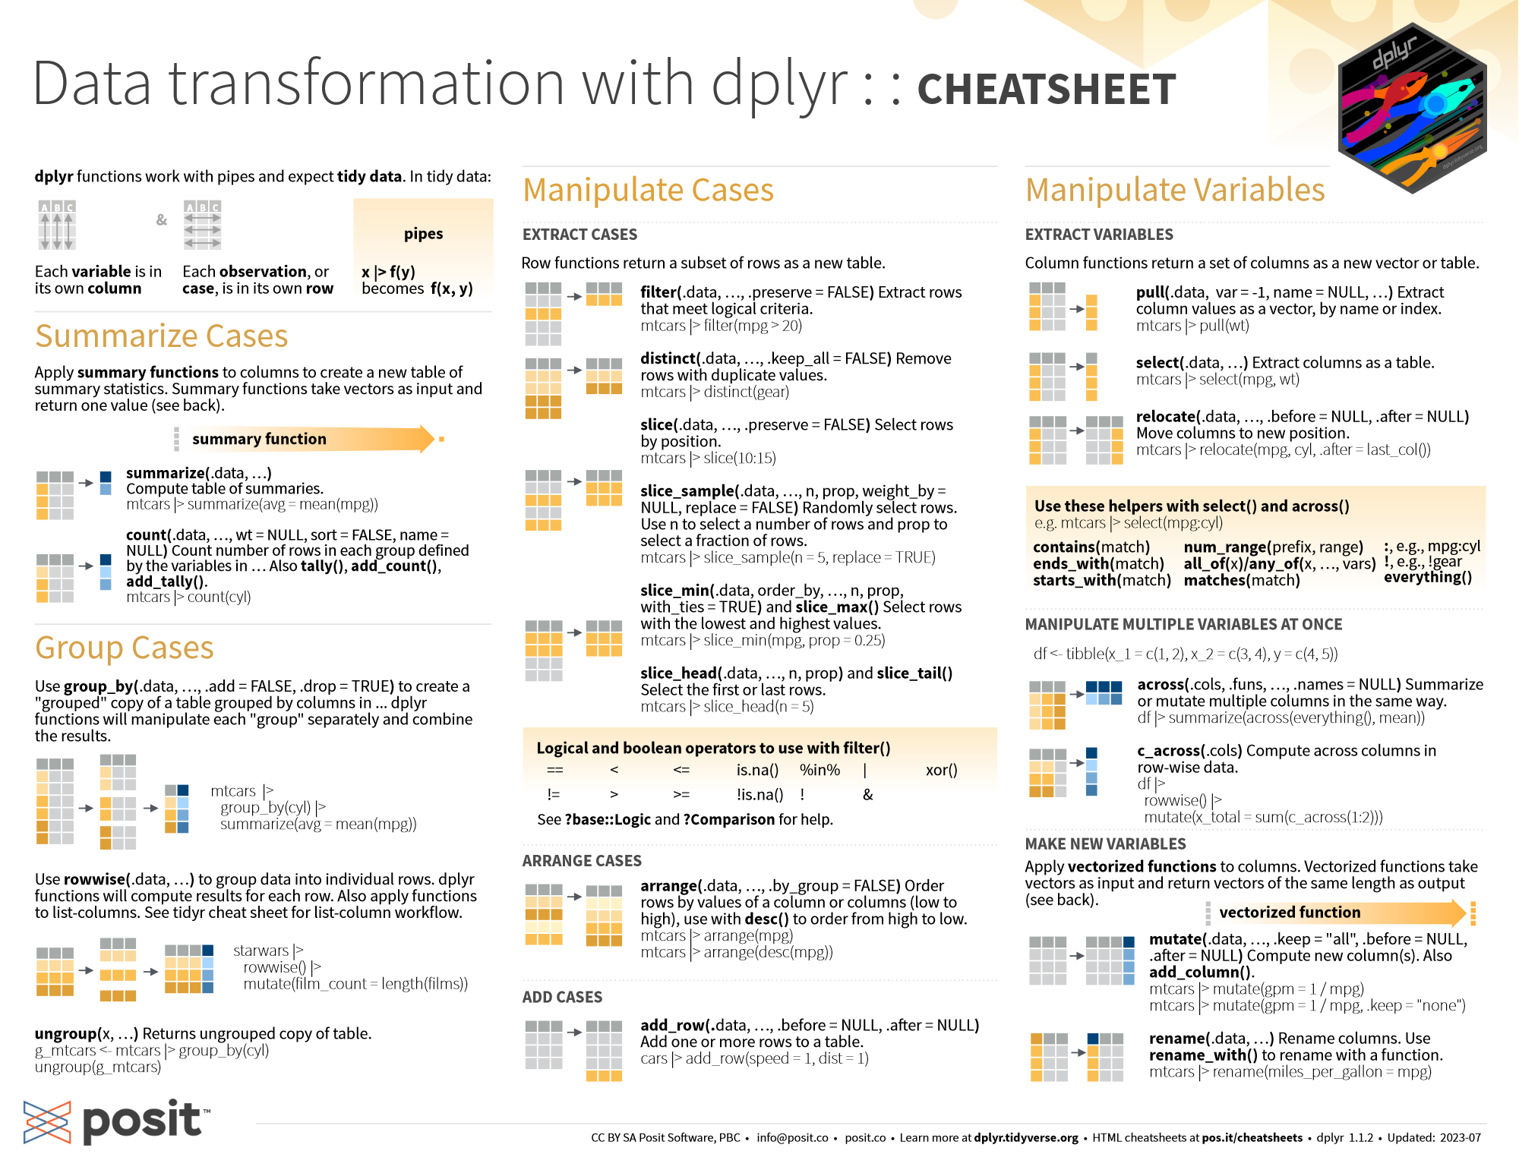
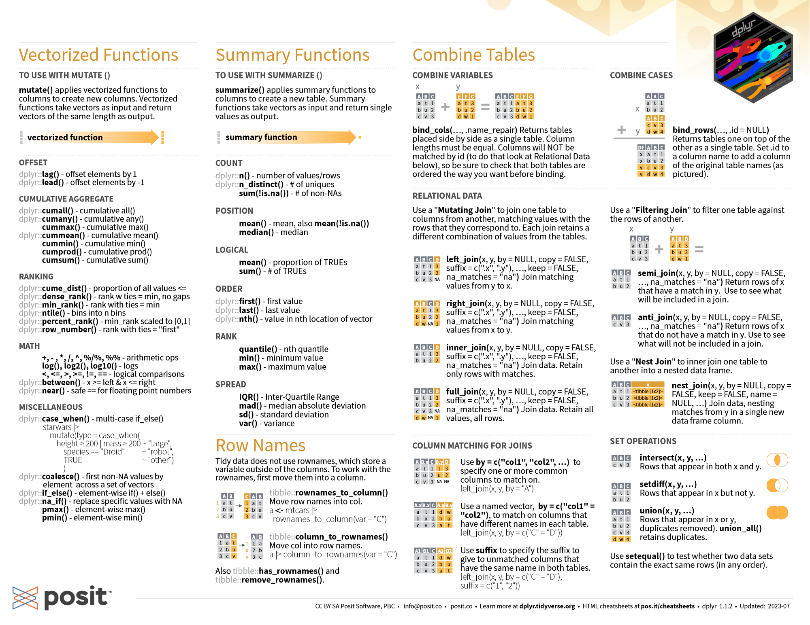
…and many more…
https://cran.r-project.org/web/packages/dplyr/vignettes/dplyr.html
https://www.tidyverse.org/
Notes:
And there’s a bajillion more data verbs for common data operations

Slide 21
Which to use? Why??
Tidyverse requires learning a new syntax
But Tidyverse’s syntax is much more concise and readable
More documentation is available for Base R
But Tidyverse is quickly gaining popularity and becoming standard
Base R is more static & stable
The power of the pipe!!!
Notes:
It’s worth circling back

Slide 22
Some data cleanup strategies… It all starts with finding the problems!
Some helpful summary functions:
names() - prints column names of a data.frame, or names of a list
str() - prints the structure of an object
summary() - prints a summary specific to an object type
head() and tail() - prints the first (or last) six rows or elements
table() - creates a table of unique values
table() everything that can be tabled
Suggestion: table(xxx, useNA="ifany")
table(xxx, yyy, useNA="ifany")
plot() everything that can be plotted
This will print unique combinations

Slide 23
A few magical tricks from external packages…
For fixing text:
str_trim() removes beginning & ending spaces of a vector or column of text
str_squish() removes beginning & ending spaces, and also collapses inner whitespace
janitor::clean_names() cleans the names of a data.frame
snakecase::to_snake_case() standardizes all text to snake_case
snakecase::to_any_case() standardizes text to any case specified
R shorthand: package::function()
Loaded with tidyverse

